Slide 1
Introduction to MongoDB

Slide 2
The Big Picture
MongoDB != RDBMS
Setting up the server Manipulating data Indexing Miscellaneous

Slide 3

I Want
Easy to use as a developer

Slide 4
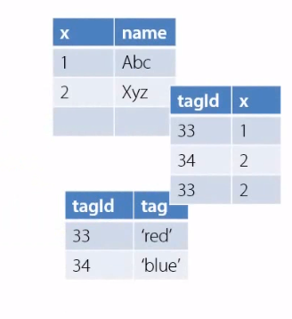
Impedance Mismatch
// your application code
class Foo { int x; string [] tags;}

Slide 5
I’m a developer
My objects are not tables and rows
My objects are not uniform

Slide 6
No Impedance Mismatch
// your application code
class Foo { int x; string [] tags;}
// mongo document for Foo
{ x: 1, tags: [‘abc’,’xyz’] }

Slide 7

I Want
Scalability

Slide 8




Scalability Issues – Relational Style
Transaction spans rows and tables
Rigid consistency model
Id This
Id
Name
Id That

Slide 9






Scalability Issues – Relational Style
Replication or sharding
Id This
Id
Name
Id That
Id | This
Id | Name
Id | That

Slide 10





Scalability Issues – Relational Style
Solutions?
1. De-normalize tables
2. Relaxed consistency
Id | This
Id | Name
Id
This
That
Name
Id | That

Slide 11
Scalability– MongoDB
No schema
Single document write scope Eventual consistency Capped Collection
Id | This
Id | Name
Id | That

Slide 12


Consistency
A
B
Primary DB
X = “123”
X = “789”

Slide 13
Consistency
A
B
Primary DB
Secondary DB
X = “123”
X = “123”
X = “789”
X = “789”

Slide 14

Consistency Choices - Complete
A
Primary DB
Secondary DB
Secondary DB
X = “123”
X = “123”
X = “123”
X = “789”
X = “789”
X = “789”

Slide 15
Consistency Choices – Fire & Forget
A
Primary DB
Secondary DB
Secondary DB
X = “123”
X = “123”
X = “123”
X = “789”
X = “789”
X = “789”

Slide 16
Consistency Choices - Majority
A
Primary DB
Secondary DB
Secondary DB
X = “123”
X = “123”
X = “123”
X = “789”
X = “789”
X = “789”

Slide 17
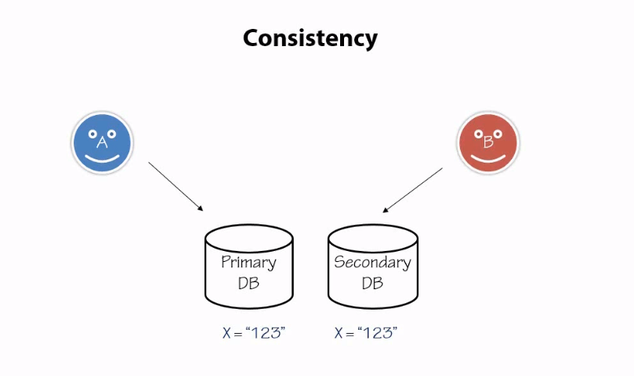

Slide 18
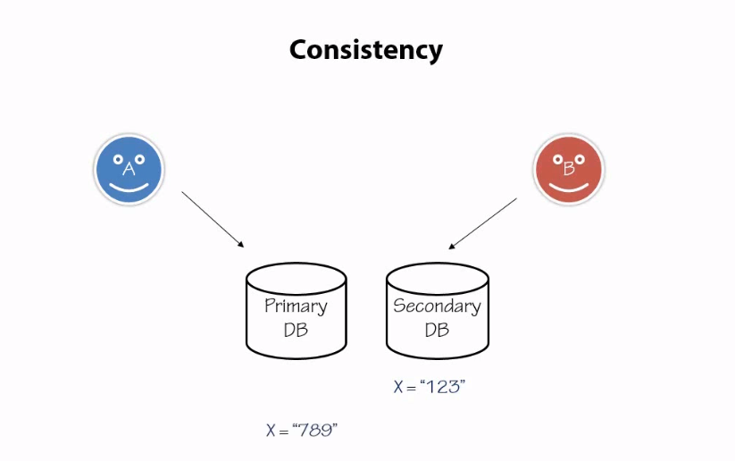

Slide 19
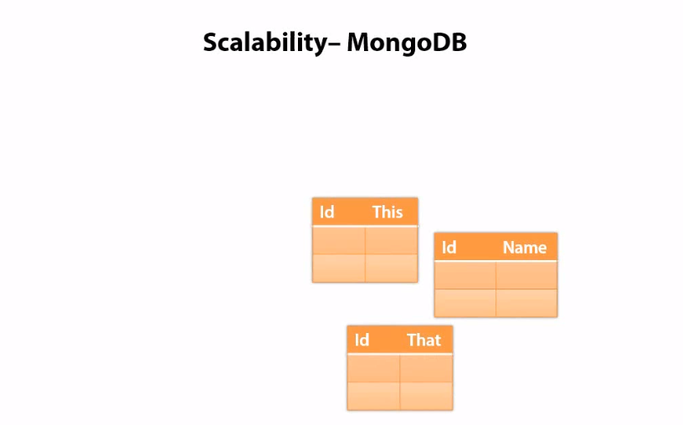

Slide 20
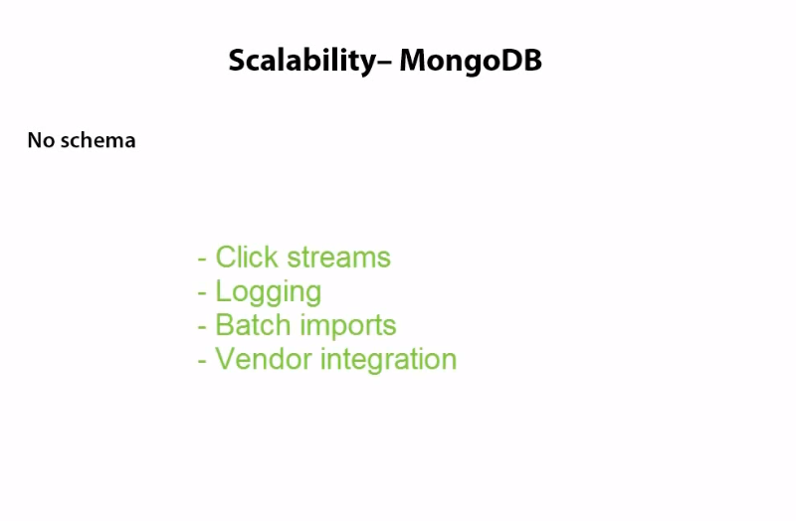

Slide 21


Summary
MongoDB
Fast
Scalable
Tunable consistency
No tables
No schema

